Slide 1


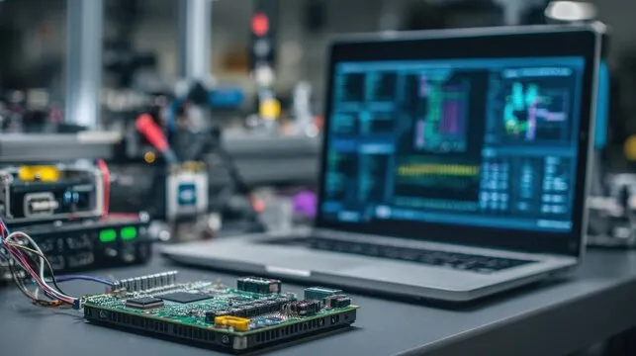
DCLab/Control System Crash Course
Embedded Software and Deterministic Multitasking
Scheduling Architecture and UART
(Universal Asynchronous Receiver-Transmitter)
Session 02
DCLab/Control System Crash Course
>_ terminal gremlin (c-lydia ^_^)
Notes:
DIRECT EDIT VERSION: All visible artwork is on this slide. Click logos, labels, footer text, rules and panels directly. Text uses ordinary text boxes. Use the Selection Pane for small objects; items are named TEXT / LOGO / SHAPE. Duplicate a complete slide to reuse the design. New Slide layouts supply only basic placeholders. Background colour: Format Background / Slide Properties.
START HERE. Duplicate the slide you need to retain all editable elements. Replace bracketed text. Use the picture placeholder icon to insert your own photo; crop to fill or fit as needed. Click a logo directly to move, resize, delete or replace its picture. All logos are original unmodified artwork. Titles use Noto Sans Mono, body text Ubuntu Sans; install these or substitute your preferred fonts consistently. 16:9 format.

Slide 2
00 / Contents
Contents
01
Blocking and Non-Blocking Execution
Blocking IO problems and its solution
02
Multitasking and Scheduling
The architecture of Task Scheduling
03
UART
Serial Communication
04
Implementation
Connecting the Theory to Physical System
DCLab/Control System Crash Course
>_ terminal gremlin (c-lydia ^_^)
Notes:
DIRECT EDIT VERSION: All visible artwork is on this slide. Click logos, labels, footer text, rules and panels directly. Text uses ordinary text boxes. Use the Selection Pane for small objects; items are named TEXT / LOGO / SHAPE. Duplicate a complete slide to reuse the design. New Slide layouts supply only basic placeholders. Background colour: Format Background / Slide Properties.
Use four actions with visible outcomes. Replace the verbs if your session has a different rhythm. Keep detail in speaker notes.

Slide 3
01 / Blocking and Non-Blocking Execution
The Problem with Blocking Waits
void blocking_wait(uint32_t ms) {
uint32_t start = millis();
while (uint32_t(millis() - start) < ms) {
// No other task in loop() can run here.
}
}
Conceptual busy wait: what happens to other loop tasks?
Source: course PDF, pp. 1–2
DCLab/Control System Crash Course
>_ terminal gremlin (c-lydia ^_^)
Notes:
Source: Embedded Software and Deterministic Multitasking.pdf, pages 1–2.
Short teaching excerpt; declarations and function context may be on adjacent slides.
This illustrates a busy wait, not the ESP32 implementation of delay(). ESP32 delay() yields the calling FreeRTOS task. See https://github.com/espressif/arduino-esp32/blob/master/cores/esp32/esp32-hal-misc.c

Slide 4
01 / Blocking and Non-Blocking Execution
What Actually Stops?
Busy wait
Keeps the calling task occupied
until the time interval expires.
ESP32 delay()
Yields the calling FreeRTOS task;
other RTOS tasks can still run.
Our loop tasks
Cannot run until loop() regains control.
Hardware PWM continues independently.
Blocking loop() delays the cooperative schedule.
Source: course PDF, pp. 1–2
DCLab/Control System Crash Course
>_ terminal gremlin (c-lydia ^_^)
Notes:
Source: Embedded Software and Deterministic Multitasking.pdf, pages 1–2.
Correction to the PDF: delay() does not freeze all CPU activity on ESP32. Primary source: https://github.com/espressif/arduino-esp32/blob/master/cores/esp32/esp32-hal-misc.c

Slide 5
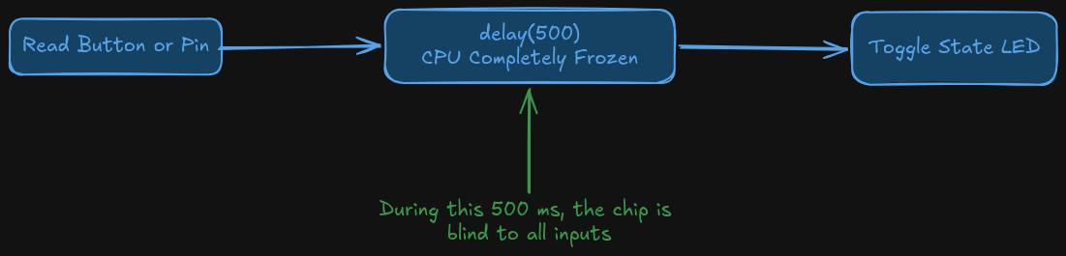
01 / Blocking and Non-Blocking Execution
The Problem with Delay
During this pause:
So, how do we solve this?
Missed input polling
Unread serial data can overflow
Delayed software output updates
DCLab/Control System Crash Course
>_ terminal gremlin (c-lydia ^_^)
Notes:
DIRECT EDIT VERSION: All visible artwork is on this slide. Click logos, labels, footer text, rules and panels directly. Text uses ordinary text boxes. Use the Selection Pane for small objects; items are named TEXT / LOGO / SHAPE. Duplicate a complete slide to reuse the design. New Slide layouts supply only basic placeholders. Background colour: Format Background / Slide Properties.
Use the photo or diagram as the evidence. The left column should explain how to read it. Picture space is approximately 16:9. Keep the source in the caption or notes.

Slide 6
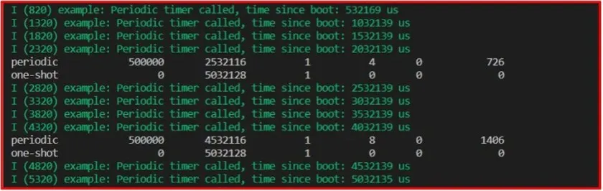
01 / Blocking and Non-Blocking Execution
Timestamp Delta Subtraction
The provided functions
What they do
millis(): returns the number of milliseconds elapsed since the chip booted as a 32-bit unsigned integer (uint32_t)
micros(): returns the number of microseconds elapsed since the chip booted as a 32-bit unsigned integer (uint32_t)
DCLab/Control System Crash Course
>_ terminal gremlin (c-lydia ^_^)
Notes:
DIRECT EDIT VERSION: All visible artwork is on this slide. Click logos, labels, footer text, rules and panels directly. Text uses ordinary text boxes. Use the Selection Pane for small objects; items are named TEXT / LOGO / SHAPE. Duplicate a complete slide to reuse the design. New Slide layouts supply only basic placeholders. Background colour: Format Background / Slide Properties.
Two independent picture placeholders. Use identical crops/scales for comparisons. Suitable for oscilloscope captures, wiring changes or debug output.

Slide 7
01 / Blocking and Non-Blocking Execution
Periodic Scheduling: Relative Reset
if (uint32_t(now - previous) >= INTERVAL) {
previous = now;
execute_task();
}
A late execution shifts the next scheduled time.
Source: course PDF, pp. 3
DCLab/Control System Crash Course
>_ terminal gremlin (c-lydia ^_^)
Notes:
Source: Embedded Software and Deterministic Multitasking.pdf, pages 3.
Short teaching excerpt; declarations and function context may be on adjacent slides.

Slide 8
01 / Blocking and Non-Blocking Execution
>_
This code causes cumulative timebase drift, why?
If a 10 ms task runs at 12 ms, resetting the timestamp to 12 ms schedules the next run for 22 ms. The 2 ms delay shifts the future schedule.
DCLab/Control System Crash Course
>_ terminal gremlin (c-lydia ^_^)
Notes:
DIRECT EDIT VERSION: All visible artwork is on this slide. Click logos, labels, footer text, rules and panels directly. Text uses ordinary text boxes. Use the Selection Pane for small objects; items are named TEXT / LOGO / SHAPE. Duplicate a complete slide to reuse the design. New Slide layouts supply only basic placeholders. Background colour: Format Background / Slide Properties.
Use the chapter title as a question. Pause for predictions. This dark transition is also useful before a live demo.

Slide 9
01 / Blocking and Non-Blocking Execution
Periodic Scheduling: Absolute Anchoring
if (uint32_t(now - previous) >= INTERVAL) {
previous += INTERVAL;
execute_task();
}
Advance by the period to keep the original time grid.
Source: course PDF, pp. 3
DCLab/Control System Crash Course
>_ terminal gremlin (c-lydia ^_^)
Notes:
Source: Embedded Software and Deterministic Multitasking.pdf, pages 3.
Short teaching excerpt; declarations and function context may be on adjacent slides.
This preserves the schedule but does not guarantee deadlines. If a task falls behind by multiple periods, this pattern catches up over successive loop passes.

Slide 10
01 / Blocking and Non-Blocking Execution
>_
This code is the standard method for periodic scheduling
Advance the timestamp by the fixed task period. A late run at 12 ms still leaves the next target at 20 ms. This prevents schedule drift, but does not remove lateness.
DCLab/Control System Crash Course
>_ terminal gremlin (c-lydia ^_^)
Notes:
DIRECT EDIT VERSION: All visible artwork is on this slide. Click logos, labels, footer text, rules and panels directly. Text uses ordinary text boxes. Use the Selection Pane for small objects; items are named TEXT / LOGO / SHAPE. Duplicate a complete slide to reuse the design. New Slide layouts supply only basic placeholders. Background colour: Format Background / Slide Properties.
Use the chapter title as a question. Pause for predictions. This dark transition is also useful before a live demo.

Slide 11
01 / Blocking and Non-Blocking Execution
When Do 32-Bit Timers Wrap?
micros()
millis()
71.58 minutes
49.71 days
2^32 microseconds
Then the counter
returns to zero.
2^32 milliseconds
Use unsigned elapsed
time subtraction.
A wrapping timestamp is normal; compare elapsed durations.
Source: course PDF, pp. 3–5
DCLab/Control System Crash Course
>_ terminal gremlin (c-lydia ^_^)
Notes:
Source: Embedded Software and Deterministic Multitasking.pdf, pages 3–5.

Slide 12
01 / Blocking and Non-Blocking Execution
Forward Addition
uint32_t deadline = millis() + INTERVAL;
void loop() {
if (millis() >= deadline) {
deadline = millis() + INTERVAL;
execute_task();
}
}
What does this code do? Would it fail?
DCLab/Control System Crash Course
>_ terminal gremlin (c-lydia ^_^)
Notes:
DIRECT EDIT VERSION: All visible artwork is on this slide. Click logos, labels, footer text, rules and panels directly. Text uses ordinary text boxes. Use the Selection Pane for small objects; items are named TEXT / LOGO / SHAPE. Duplicate a complete slide to reuse the design. New Slide layouts supply only basic placeholders. Background colour: Format Background / Slide Properties.
Full-width editable code. Duplicate this slide and use the syntax-colouring helper for a longer snippet. The same helper accepts cpp, c, python, bash, json, yaml and other Pygments language aliases. Sample is illustrative pseudocode in C++ syntax, not complete firmware.

Slide 13
01 / Blocking and Non-Blocking Execution
>_
This code would fail
millis() wraps from 4,294,967,295 back to 0 while deadline is an absolute timestamp, the >= comparison stops reflecting real time order near the rollover, so the task misfires (or stalls) until the two values line up again.
DCLab/Control System Crash Course
>_ terminal gremlin (c-lydia ^_^)
Notes:
DIRECT EDIT VERSION: All visible artwork is on this slide. Click logos, labels, footer text, rules and panels directly. Text uses ordinary text boxes. Use the Selection Pane for small objects; items are named TEXT / LOGO / SHAPE. Duplicate a complete slide to reuse the design. New Slide layouts supply only basic placeholders. Background colour: Format Background / Slide Properties.
Use the chapter title as a question. Pause for predictions. This dark transition is also useful before a live demo.

Slide 14
01 / Blocking and Non-Blocking Execution
Unsigned Subtraction Handles Rollover
if (uint32_t(now - previous) >= INTERVAL) {
previous += INTERVAL;
execute_task();
}
Example: uint32_t(5 - 4294967290) gives 11 elapsed ticks.
Source: course PDF, pp. 4–5
DCLab/Control System Crash Course
>_ terminal gremlin (c-lydia ^_^)
Notes:
Source: Embedded Software and Deterministic Multitasking.pdf, pages 4–5.
Short teaching excerpt; declarations and function context may be on adjacent slides.
Valid when elapsed time is less than one full timer wrap; task checks must occur often enough to avoid missing a full wrap.

Slide 15
01 / Blocking and Non-Blocking Execution
>_
This code would work
Unsigned subtraction wraps modulo 2³². For example, 5 − 4,294,967,290 gives 11 elapsed ticks. Check often enough that less than one full timer wrap passes.
DCLab/Control System Crash Course
>_ terminal gremlin (c-lydia ^_^)
Notes:
DIRECT EDIT VERSION: All visible artwork is on this slide. Click logos, labels, footer text, rules and panels directly. Text uses ordinary text boxes. Use the Selection Pane for small objects; items are named TEXT / LOGO / SHAPE. Duplicate a complete slide to reuse the design. New Slide layouts supply only basic placeholders. Background colour: Format Background / Slide Properties.
Use the chapter title as a question. Pause for predictions. This dark transition is also useful before a live demo.

Slide 16
01 / Blocking and Non-Blocking Execution
Execution Budgets and Timing
PERIOD
CPU LOAD
LATENESS
10,000 us
T_exec / T_period
Actual − target
100 Hz means one
release every 10 ms.
Example: 20 us /
10,000 us = 0.2%.
How late the task
starts relative to
its scheduled slot.
Keep tasks short and leave time for other work.
Source: course PDF, pp. 5–6
DCLab/Control System Crash Course
>_ terminal gremlin (c-lydia ^_^)
Notes:
Source: Embedded Software and Deterministic Multitasking.pdf, pages 5–6.
The PDF conflates fractional utilization and percent. Per-task utilization alone does not guarantee deadlines in a cooperative scheduler; blocking and total workload also matter.

Slide 17
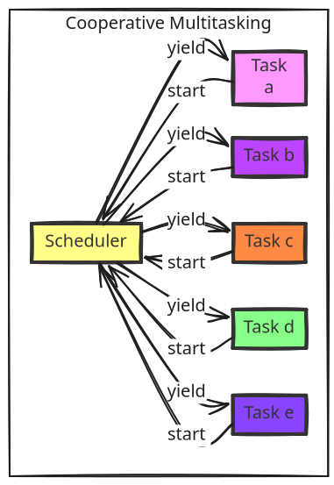
02 / Multitasking and Scheduling
Principles of Cooperative Multitasking
Cooperative (Non-Preemptive) Multitasking
These functions run cooperatively inside loop(). ESP32 still runs FreeRTOS underneath.
Each function does a small amount of work and returns promptly.
A long task delays the others in this loop.
DCLab/Control System Crash Course
>_ terminal gremlin (c-lydia ^_^)
Notes:
DIRECT EDIT VERSION: All visible artwork is on this slide. Click logos, labels, footer text, rules and panels directly. Text uses ordinary text boxes. Use the Selection Pane for small objects; items are named TEXT / LOGO / SHAPE. Duplicate a complete slide to reuse the design. New Slide layouts supply only basic placeholders. Background colour: Format Background / Slide Properties.
Best for circuit diagrams, timing plots, architecture exports and screenshots. Use Fit rather than Fill when cropping would hide labels. Prefer the editable architecture layout when creating a new diagram.

Slide 18
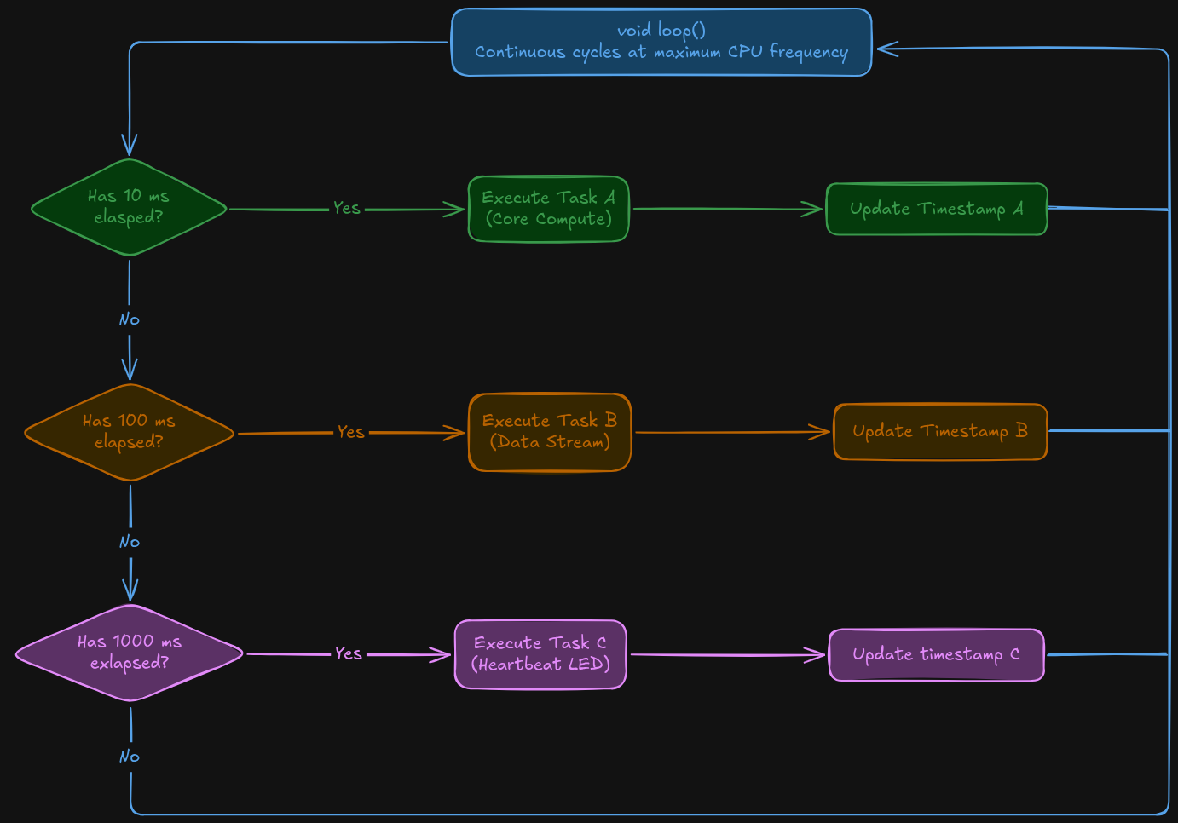
02 / Multitasking and Scheduling
Cooperative Non-Blocking Task Cycle
Every task function must execute and return in a fraction of its total period
Never call delay() or long blocking while() loops inside periodic task
DCLab/Control System Crash Course
>_ terminal gremlin (c-lydia ^_^)
Notes:
DIRECT EDIT VERSION: All visible artwork is on this slide. Click logos, labels, footer text, rules and panels directly. Text uses ordinary text boxes. Use the Selection Pane for small objects; items are named TEXT / LOGO / SHAPE. Duplicate a complete slide to reuse the design. New Slide layouts supply only basic placeholders. Background colour: Format Background / Slide Properties.
Best for circuit diagrams, timing plots, architecture exports and screenshots. Use Fit rather than Fill when cropping would hide labels. Prefer the editable architecture layout when creating a new diagram.

Slide 19
02 / Multitasking and Scheduling
A Reusable Periodic Task
struct PeriodicTask {
uint32_t last = 0, period;
bool ready(uint32_t now) {
if (uint32_t(now - last) < period) return false;
last += period;
return true;
}
};
Create independent timers, for example: PeriodicTask motion{0, 10000};
Source: course PDF, pp. 7–8
DCLab/Control System Crash Course
>_ terminal gremlin (c-lydia ^_^)
Notes:
Source: Embedded Software and Deterministic Multitasking.pdf, pages 7–8.
Short teaching excerpt; declarations and function context may be on adjacent slides.
Corrects the reversed comparison and malformed constructor in the draft. Initialize last after setup to avoid catching up startup time. This is an aggregate initialized with last and period.

Slide 20
02 / Multitasking and Scheduling
>_
This is how we structure Multi-Rate Periodic Tasks
Run fast computational tasks at 100 Hz and slower I/O tasks at 10 Hz to maintain responsiveness and avoid overloading communication buses.
DCLab/Control System Crash Course
>_ terminal gremlin (c-lydia ^_^)
Notes:
DIRECT EDIT VERSION: All visible artwork is on this slide. Click logos, labels, footer text, rules and panels directly. Text uses ordinary text boxes. Use the Selection Pane for small objects; items are named TEXT / LOGO / SHAPE. Duplicate a complete slide to reuse the design. New Slide layouts supply only basic placeholders. Background colour: Format Background / Slide Properties.
Use the chapter title as a question. Pause for predictions. This dark transition is also useful before a live demo.

Slide 21
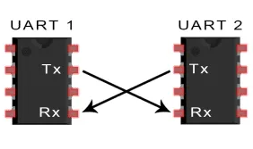
03 / UART
UART Physical Sampling and 8-N-1 Asynchronous Framing
UART has no shared clock; both ends must agree on baud rate and framing.
Mark (logic 1): idle HIGH, about 3.3 V on this ESP32.
Space (logic 0): LOW, near GND.
DCLab/Control System Crash Course
>_ terminal gremlin (c-lydia ^_^)
Notes:
DIRECT EDIT VERSION: All visible artwork is on this slide. Click logos, labels, footer text, rules and panels directly. Text uses ordinary text boxes. Use the Selection Pane for small objects; items are named TEXT / LOGO / SHAPE. Duplicate a complete slide to reuse the design. New Slide layouts supply only basic placeholders. Background colour: Format Background / Slide Properties.
Best for circuit diagrams, timing plots, architecture exports and screenshots. Use Fit rather than Fill when cropping would hide labels. Prefer the editable architecture layout when creating a new diagram.

Slide 22
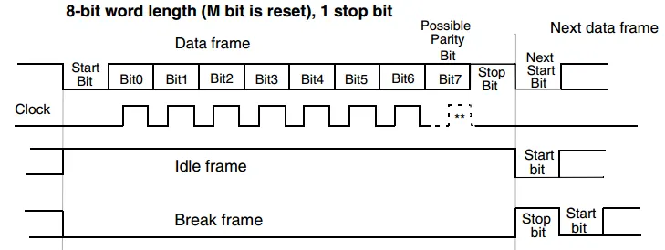
03 / UART
UART Frame Structure
DCLab/Control System Crash Course
>_ terminal gremlin (c-lydia ^_^)
Notes:
DIRECT EDIT VERSION: All visible artwork is on this slide. Click logos, labels, footer text, rules and panels directly. Text uses ordinary text boxes. Use the Selection Pane for small objects; items are named TEXT / LOGO / SHAPE. Duplicate a complete slide to reuse the design. New Slide layouts supply only basic placeholders. Background colour: Format Background / Slide Properties.
Best for circuit diagrams, timing plots, architecture exports and screenshots. Use Fit rather than Fill when cropping would hide labels. Prefer the editable architecture layout when creating a new diagram.

Slide 23
03 / UART
UART Frame: What Each Bit Does
Start: 1 bit
The line changes from idle HIGH to LOW
to mark the beginning of the frame.
Data: 8 bits
Transmit the payload one bit at a time,
least significant bit first.
Stop: 1 bit
Return to HIGH for at least one bit time
before the next frame.
8-N-1: 1 start + 8 data + 0 parity + 1 stop = 10 bits per byte.
Source: course PDF, pp. 9
DCLab/Control System Crash Course
>_ terminal gremlin (c-lydia ^_^)
Notes:
Source: Embedded Software and Deterministic Multitasking.pdf, pages 9.

Slide 24
03 / UART
UART Capacity at 115200 Baud
ONE BIT
ONE BYTE
MAXIMUM RATE
8.68 us
86.81 us
11,520 B/s
1 / 115200 seconds
8-N-1 uses 10 bits:
1 start + 8 data
+ 1 stop.
115200 / 10
Payload bytes
per second.
The UART framing overhead counts toward the wire bandwidth.
Source: course PDF, pp. 9
DCLab/Control System Crash Course
>_ terminal gremlin (c-lydia ^_^)
Notes:
Source: Embedded Software and Deterministic Multitasking.pdf, pages 9.

Slide 25
03 / UART
Too Much Logging in a Fast Task
void task_100Hz() {
// Assume each formatted message is 120 bytes.
Serial.printf("Cycle: %lu, Value: %.2f ...\n",
cycle_count, value);
}
120 bytes × 100 Hz = 12,000 B/s: more than UART can transmit.
Source: course PDF, pp. 10
DCLab/Control System Crash Course
>_ terminal gremlin (c-lydia ^_^)
Notes:
Source: Embedded Software and Deterministic Multitasking.pdf, pages 10.
Short teaching excerpt; declarations and function context may be on adjacent slides.
Illustrative excerpt. The shown abbreviated format is not itself 120 bytes; the bandwidth example assumes a measured full message length of 120 bytes. Serial.printf, not println, supports format arguments.

Slide 26
03 / UART
Why Serial Printing Can Stall
GENERATED
TRANSMITTED
RESULT
12,000 B/s
11,520 B/s
Buffer pressure
120-byte message
at 100 Hz
115200 baud
with 8-N-1 framing
When writes cannot
queue, they can wait
for UART progress.
A 120-byte frame takes about 10.42 ms on the wire.
Source: course PDF, pp. 10
DCLab/Control System Crash Course
>_ terminal gremlin (c-lydia ^_^)
Notes:
Source: Embedded Software and Deterministic Multitasking.pdf, pages 10.
Exact blocking behavior and buffer sizes depend on core version and configuration. Avoid repeating the PDF claim that every buffer fills in less than 200 ms.

Slide 27
03 / UART
Move Telemetry to a Slower Task
CONTROL
TELEMETRY
UART LOAD
100 Hz
10 Hz
10.4%
Update the PWM
without verbose
serial output.
120 bytes × 10 Hz
= 1,200 B/s
1,200 / 11,520
Leaves substantial
wire capacity.
Separate control timing from communication timing.
Source: course PDF, pp. 10–11
DCLab/Control System Crash Course
>_ terminal gremlin (c-lydia ^_^)
Notes:
Source: Embedded Software and Deterministic Multitasking.pdf, pages 10–11.
Lower average load helps; bursts, other serial writers, and formatting time can still cause delays.

Slide 28
03 / UART
Format Data for the Serial Plotter
Serial.printf("PWM_Duty: %u, Theoretical_V: %.3f\n",
unsigned(duty), duty * 3.3f / 255.0f);
Use label: value pairs, commas between metrics, and a newline.
Source: course PDF, pp. 11
DCLab/Control System Crash Course
>_ terminal gremlin (c-lydia ^_^)
Notes:
Source: Embedded Software and Deterministic Multitasking.pdf, pages 11.
Short teaching excerpt; declarations and function context may be on adjacent slides.
Shortened variable names are used in the implementation slides. The theoretical voltage is the average GPIO output, not a motor supply voltage.

Slide 29
03 / UART
Check UART with a Multimeter
Power OFF
Check TX-to-RX continuity.
Check that TX is not shorted to GND.
Idle, power ON
A configured 3.3 V UART TX line
is normally HIGH when idle.
Active traffic
The meter shows an average voltage.
Use a logic analyzer to decode bytes.
A multimeter checks electrical state, not baud rate or packet contents.
Source: course PDF, pp. 11–12
DCLab/Control System Crash Course
>_ terminal gremlin (c-lydia ^_^)
Notes:
Source: Embedded Software and Deterministic Multitasking.pdf, pages 11–12.
Corrects the PDF wording about a short from TX to GND: no short should be present. Active average voltage depends on payload and idle time; it cannot uniquely diagnose a baud mismatch. GPIO 1 is the classic ESP32 UART0 TX, not universal across ESP32 boards.

Slide 30
03 / UART
Check the 3.3 V Supply
Probe
Measure between 3V3 and GND
while the scheduler runs.
Observe
Look for a steady supply near 3.3 V
during computation and transmission.
If it resets
Inspect USB power, connections,
and voltage drops under load.
A normal meter reading can miss short supply dips.
Source: course PDF, pp. 12
DCLab/Control System Crash Course
>_ terminal gremlin (c-lydia ^_^)
Notes:
Source: Embedded Software and Deterministic Multitasking.pdf, pages 12.
Do not treat the PDF’s brownout threshold or voltage band as a universal ESP32 specification. Thresholds depend on chip and configuration.

Slide 31
04 / Implementation
Lab Connections
GPIO 18
PWM output → resistor → LED → GND
GPIO 4
Heartbeat output → resistor → LED → GND
USB + GND
USB powers the board and carries logs.
Share a ground reference for measurements.
Use separate current-limiting resistors and verify LED polarity.
Source: course PDF, pp. 13–17
DCLab/Control System Crash Course
>_ terminal gremlin (c-lydia ^_^)
Notes:
Source: Embedded Software and Deterministic Multitasking.pdf, pages 13–17.
Derived from the PDF wiring and firmware. GPIO 4 is the dedicated heartbeat pin; the PDF test section incorrectly names GPIO 2 / 18. LED resistor selection depends on the LED; use the lab hardware values.

Slide 32
04 / Implementation
Before Connecting USB
Ground path
Confirm continuity along the
intended common ground rail.
Power rails
Check for a persistent low-resistance
short between 3V3 and GND.
Wiring
Check GPIO 18, GPIO 4, resistor paths,
and LED polarity before power-up.
Use continuity and resistance modes only with power disconnected.
Source: course PDF, pp. 13
DCLab/Control System Crash Course
>_ terminal gremlin (c-lydia ^_^)
Notes:
Source: Embedded Software and Deterministic Multitasking.pdf, pages 13.
A charging capacitor can change the resistance reading. The PDF’s blanket >100 kohm requirement is not a universal pass criterion for a populated board. USB shield bonding is also board-specific.

Slide 33
04 / Implementation
One Loop, Three Task Rates
MOTION
TELEMETRY
HEARTBEAT
100 Hz
10 Hz
1 Hz task
Every 10 ms
Update the PWM
duty ramp.
Every 100 ms
Print state and
timing metrics.
Every 1 second
Toggle the status
LED on GPIO 4.
Check each timer independently; keep every task short.
Source: course PDF, pp. 14–19
DCLab/Control System Crash Course
>_ terminal gremlin (c-lydia ^_^)
Notes:
Source: Embedded Software and Deterministic Multitasking.pdf, pages 14–19.
The heartbeat task toggles once per second. The full LED on/off cycle lasts two seconds (0.5 Hz).

Slide 34
04 / Implementation / Firmware 01 of 04
Firmware: Configure the Hardware
Serial.begin(115200);
pinMode(4, OUTPUT);
if (!ledcAttachChannel(18, 20000, 8, 0)) {
while (true) delay(1000);
}
ledcWrite(18, 0);
GPIO 18: 20 kHz PWM, 8-bit duty. GPIO 4: heartbeat LED.
DCLab/Control System Crash Course
>_ terminal gremlin (c-lydia ^_^)
Notes:
Source: Embedded Software and Deterministic Multitasking.pdf, pages 14–17.
Short teaching excerpt; declarations and function context may be on adjacent slides.
Inside setup(). Print a fatal diagnostic before stopping if LEDC attachment fails.
Initialize GPIO 4 LOW. At the end of setup(), set lastMotion = micros(), lastTelemetry = millis(), and lastHeartbeat = lastTelemetry.
Global state for the following excerpts:
uint32_t lastMotion = 0, lastTelemetry = 0, lastHeartbeat = 0;
uint8_t duty = 0;
int8_t direction = 1;
bool ledState = false;
Arduino-ESP32 3.x pin-based LEDC API. These are important excerpts from the full PDF firmware, not independent sketches.

Slide 35
04 / Implementation / Firmware 02 of 04
Firmware: Schedule Three Tasks
if (uint32_t(micros() - lastMotion) >= 10000) {
lastMotion += 10000;
task_motion_control();
}
if (uint32_t(millis() - lastTelemetry) >= 100) {
lastTelemetry += 100;
task_telemetry();
}
if (uint32_t(millis() - lastHeartbeat) >= 1000) {
lastHeartbeat += 1000;
task_heartbeat();
}
Inside loop(): motion 100 Hz · telemetry 10 Hz · heartbeat 1 Hz.
DCLab/Control System Crash Course
>_ terminal gremlin (c-lydia ^_^)
Notes:
Source: Embedded Software and Deterministic Multitasking.pdf, pages 18–19.
Short teaching excerpt; declarations and function context may be on adjacent slides.
Use independent if statements so all ready tasks get checked. Unsigned elapsed subtraction handles timer wrap when checks occur often enough. Advance timestamps by fixed periods to preserve the scheduling grid. Initialize epochs after setup; do not start with stale zero epochs after a long initialization.
Timing instrumentation can wrap the motion call:
uint32_t startUs = micros();
task_motion_control();
execUs = micros() - startUs;
if (execUs > maxExecUs) maxExecUs = execUs;
Declare uint32_t execUs = 0, maxExecUs = 0 globally. Replace the existing motion call; do not call it twice.
For lateness, sample nowUs before the due check and calculate uint32_t(nowUs - lastMotion) - 10000 inside the due branch before advancing lastMotion. The PDF calls this Jitter_us, but it measures scheduling lateness.

Slide 36
04 / Implementation / Firmware 03 of 04
Firmware: Apply, Reverse, and Step
void task_motion_control() {
ledcWrite(18, duty);
if (duty == 255) direction = -1;
else if (duty == 0) direction = 1;
duty += direction;
}
One duty step every 10 ms: 0 → 255 → 0 in about 5.1 seconds.
DCLab/Control System Crash Course
>_ terminal gremlin (c-lydia ^_^)
Notes:
Source: Embedded Software and Deterministic Multitasking.pdf, pages 15.
Short teaching excerpt; declarations and function context may be on adjacent slides.
Same apply/reverse/step sequence as the PDF. Direction changes before adding a signed step, so duty remains in 0–255. Hardware PWM generates the 20 kHz carrier continuously; software updates the duty at 100 Hz. duty holds the next step after the function returns, so telemetry reads applied duty from the hardware.

Slide 37
04 / Implementation / Firmware 04 of 04
Firmware: Telemetry and Heartbeat
void task_telemetry() {
Serial.printf("PWM_Duty: %u\n",
unsigned(ledcRead(18)));
}
void task_heartbeat() {
ledState = !ledState;
digitalWrite(4, ledState);
}
Print at 10 Hz; toggle GPIO 4 once per second.
DCLab/Control System Crash Course
>_ terminal gremlin (c-lydia ^_^)
Notes:
Source: Embedded Software and Deterministic Multitasking.pdf, pages 16, 19.
Short teaching excerpt; declarations and function context may be on adjacent slides.
Telemetry is intentionally reduced to one field for a readable slide. In the full sketch, also report Theoretical_V = appliedDuty * 3.3f / 255.0f, execution time, maximum execution time, and scheduling lateness. Keep printing in the 10 Hz task. A GPIO 4 toggle each second produces a complete on/off cycle every two seconds. The heartbeat pin is GPIO 4, correcting inconsistent pins in the PDF testing instructions.

Slide 38
04 / Implementation
Verify Data
Upload + observe
Use Serial Monitor at 115200 baud.
Expect about 10 telemetry lines per second.
Plot + measure
Plot the duty ramp; measure GPIO 18.
Its average voltage rises and falls.
Compare
GPIO 4 changes state every second.
Check a steady 3.3 V supply and task timing.
Compare the physical outputs with the firmware’s predicted behavior.
Source: course PDF, pp. 19
DCLab/Control System Crash Course
>_ terminal gremlin (c-lydia ^_^)
Notes:
Source: Embedded Software and Deterministic Multitasking.pdf, pages 19.
Select the correct ESP32 board and USB port; upload the complete firmware. The slide snippets are excerpts, not independent sketches. In Serial Plotter, PWM_Duty should form a 0–255 triangle with an approximately 5.1 s full cycle. Theoretical_V is the average GPIO output prediction, not motor voltage. A multimeter averages the PWM and may lag the ramp. GPIO 4 toggles once per second. Timing and voltage tolerances depend on hardware and software; measure them rather than assuming the PDF example values are guaranteed. Plot timing separately if its scale obscures the duty curve.

Slide 39
04 / Implementation
Debugging
Unreadable serial
Match the monitor to 115200 baud;
confirm the correct USB serial port.
Erratic heartbeat
Remove long waits from loop tasks;
keep verbose logging at 10 Hz.
Timing spikes
Measure task execution time; move
formatting out of the 100 Hz task.
Check communication settings, blocking calls, and task execution time.
Source: course PDF, pp. 20
DCLab/Control System Crash Course
>_ terminal gremlin (c-lydia ^_^)
Notes:
Source: Embedded Software and Deterministic Multitasking.pdf, pages 20.
These combine the source’s three debugging cases. If the board resets, also inspect USB power, wiring, and rail stability. Exact execution time depends on the board, Arduino core version, interrupts, and workload. A small average utilization does not rule out a long blocking operation.

Slide 40
>_ KEEP EXPLORING ^_^
References
Making Embedded Systems:
Design Patterns for Great Software
ESP32 Arduino Core Documentation:
Serial (UART)
Elecia White
Espressif Systems
The Art of Electronics:
Student Manual
ESP32 Programming Guide:
General Purpose Timer (GPTimer)
Thomas C. Hayes and Paul Horowitz
Espressif Systems
Computer Systems:
A Programmer’s Perspective
Arduino Core for the ESP32
Randal E. Bryant and David R. O’Hallaron
Espressif Systems
Embedded Software and
Deterministic Multitasking
ESP32 Arduino Core Documentation:
LED Control (LEDC)
DCLab / course notes
Espressif Systems
DCLab/Control System Crash Course
>_ terminal gremlin (c-lydia ^_^)
Notes:
Source: Embedded Software and Deterministic Multitasking.pdf, pages 20.
Primary course source: the PDF in this directory. Other PDF references: Computer Systems: A Programmer’s Perspective — Randal E. Bryant and David R. O’Hallaron; The Art of Electronics: Student Manual — Thomas C. Hayes and Paul Horowitz. API verification: https://docs.espressif.com/projects/arduino-esp32/en/latest/api/ledc.html ; https://docs.espressif.com/projects/arduino-esp32/en/latest/api/serial.html ; https://docs.espressif.com/projects/esp-idf/en/stable/esp32/api-reference/peripherals/gptimer.html . ESP32 delay implementation: https://github.com/espressif/arduino-esp32/blob/master/cores/esp32/esp32-hal-misc.c

Slide 41
SESSION 02 / EMBEDDED SOFTWARE & MULTITASKING
Thank you!
Questions & discussion
TIMING
SCHEDULING
UART
DCLab/Control System Crash Course
>_ terminal gremlin (c-lydia ^_^)
Notes:
Session 02 closing: clock, staggered task slots, and serial bits represent timing, scheduling, and UART. This is a conceptual illustration, not a measured trace or hardware data-flow diagram. Invite questions and discussion.

